Slide 1
SUPPORT VECTOR MACHINE
ANIKET PATIL

Slide 2
SUPPORT VECTOR MACHINE
Supervised learning algorithms
Used for
Classification
Regression
SVM algorithm helps to find the best line or decision boundary called hyperplane that classify the data points.
SVM chooses the extreme points/vectors that help in creating hyperplane or decision boundry. These extreme cases are called as support vectors, and hence algorithm called as support machine.

Slide 3
Types of SVM
Linear SVM(LSVM): Linear SVM is used for linearly separable data, which means if a dataset can be classified into two classes by using a single straight line, then such data is termed as linearly separable data, and classifier is used called as Linear SVM classifier.
Non-linear SVM (NLSVM): Non-Linear SVM is used for non-linearly separated data, which means if a dataset cannot be classified by using a straight line, then such data is termed as non-linear data and classifier used is called as Non-linear SVM classifier.

Slide 4
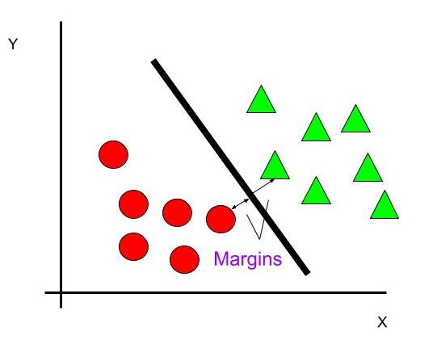
LSVM
hyperplane
Support vector

Slide 5
Hyperplane
The SVM algorithm helps to find the best line or decision boundary, this be boundary or region is called as a hyperplane.
decision boundary that helps to classify the data points.
We always create a hyperplane that has a maximum margin, which means the maximum distance between the data points.
The hyperplane with maximum margin is called the optimal hyperplane.

Slide 6
Support Vectors & Margin
Support Vectors : The data points or vectors that are the closest to the hyperplane.
SVM algorithm finds the closest point of the lines from both the classes. These points are called support vectors.
Margin : The distance between the support vectors and the hyperplane is called as margin and the goal of SVM is to maximize this margin.

Slide 7
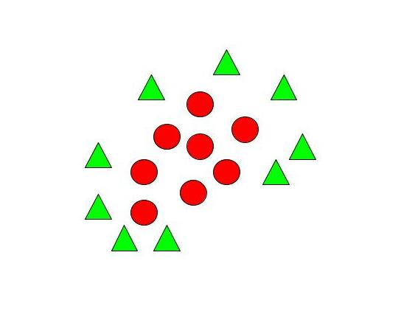
NLSVM
for non-linear data, we cannot draw a single straight line, here we use NLSVM Classifier.

Slide 8
Kernels
A kernel transforms a low-dimensional input data space into a higher dimensional space.
So, it converts non-linear separable problems to linear separable problems by adding more dimensions to it. Thus, the kernel trick helps us to build a more accurate classifier. Hence, it is useful in non-linear separation problems.
In the context of SVMs, there are 4 popular kernels –
Linear kernel,
Polynomial kernel,
Radial Basis Function (RBF) kernel (also called Gaussian kernel) and
Sigmoid kernel.

Slide 9
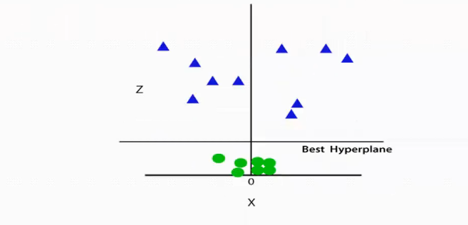
To separate these data points, we need to add one more dimension. For linear data, we have used two dimensions x and y, so for non-linear data, we will add a third dimension z. It can be calculated
z=x² +y²
By adding the third dimension, the sample space will become as below .image:

Slide 10
Difference
Linear SVM | Non-Linear SVM
It can be easily separated with a linear line. | It cannot be easily separated with a linear line.
Data is classified with the help of hyperplane. | We use Kernels to make non-separable data into separable data.
Data can be easily classified by drawing a straight line. | We map data into high dimensional space to classify.

Slide 11
Advantages of SVM
Good for smaller cleaner datasets.
Accurate results.
Useful for both linearly separable data and non – linearly separable data.
Effective in high dimensional spaces.

Slide 12
Disadvantages of SVM
Not suitable for large datasets, as the training time can be too much.
Not so effective on a dataset with overlapping classes.
Picking the right kernel can be computationally intensive.

Slide 13
Application of SVM
Face detection
SVM classify parts of the image as a face and non-face and create a square boundary around the face.
Text and hypertext categorization
They use training data to classify documents into different categories. It categorizes on the basis of the score generated and then compares with the threshold value.
It Uses training data to classify documents into different categories such as news articles, e-mails, and web pages
Examples:
Classification of news articles into "business" and "Movies“
Classification of web pages into personal home pages and others
Sentiment analysis.
Spam Detection.
Handwritten digit recognition.
Image recognition challenges

